Slide 1
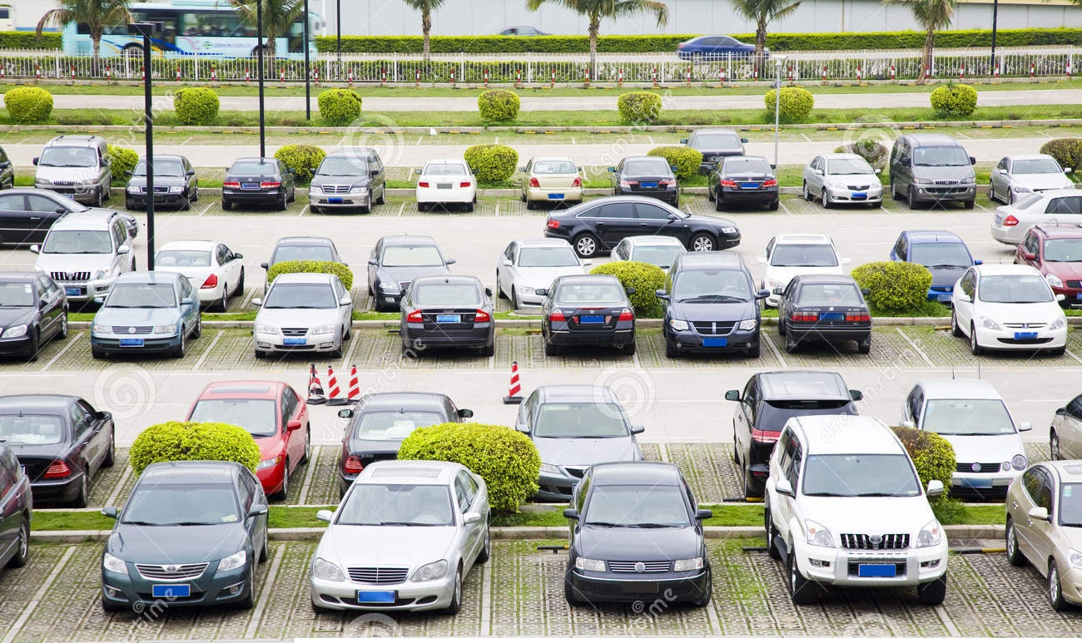
Easy parking
Sadia Shromin (Team Leader)
Charles Chukwuma Odunukwe
Anitha Palusa
Bede Eze
Adil Nowshad

Slide 2
Outlines
Introduction and problem description
Goal and purpose
Tools and framework
Use case diagram
System architecture
Prototype of the mobile application
State Diagram
Sequence diagram
System implementation
web management system Development & Demo
Mobile app Development & Demo
System testing
Conclusion

Slide 3
Introduction and problem description
In our project we are trying to make the parking easy by developing a mobile application to find the closest parking spots and available space to park the vehicle. The idea of our project came from observing the inefficiency of current methods of parking enforcement.
Students miss their exam schedule,
Passengers miss their flights schedule finding for the vacant parking.
Congestion often caused by drivers roaming around the floors and checking parking spot.
Under this condition, our easy parking reservation app is provided to deal with the issues we are facing.

Slide 4
Goal and purpose
The purpose of this project is
To develop a car park reservation system to address and tackle the above daily problems.
To allow users to also reserve the parking lot for specific duration of time.
Ultimately, saving in time, fuel and a better parking experience could be achieved by using this system.

Slide 5

Logo Design

Slide 6
Easy parking
Use case diagram
Can signup and login
Can View list of nearby parking slots
Can set the duration of time for parking
Can make a reservation
User
Admin
Can see the reservation start and end time
Can cancel the reservation
Can add/edit/delete parkingSpot information

Slide 7
Tools and framework
React Native platform, Xcode as emulator
App Development
KanbanFlow,
FluidUI,
Gliffy,
photoshop
MYSQL,
HIBERNATE
Project planning & Management
Visual studio,
ASP.NET MVC
Google Map API
REST API &
Database
Web Development

Slide 8



System architecture
Our system can be divided into five sections –
Database server
Web application server
RESTful web service
Administrative front-end
Mobile-based frontend (easypark mobile app)
Database
Web Server
Business logic
REST API

Slide 9
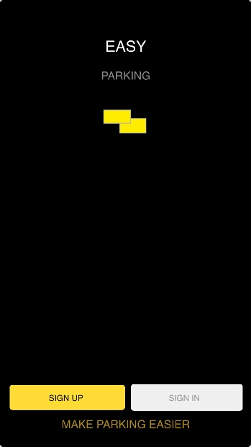
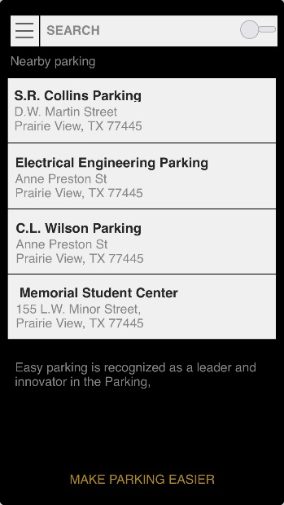
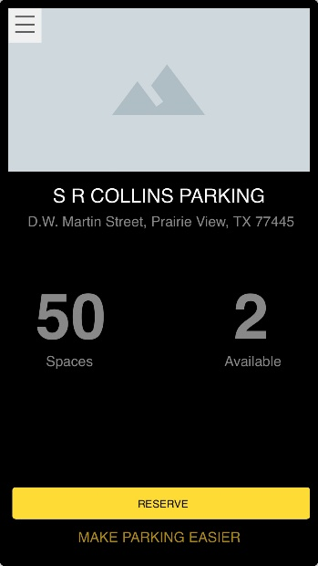
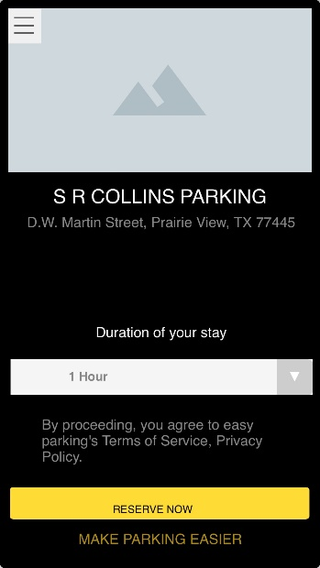
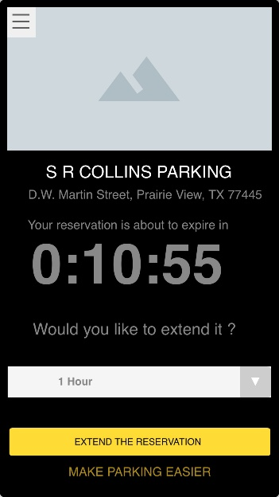
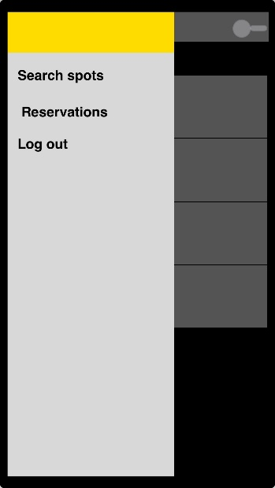
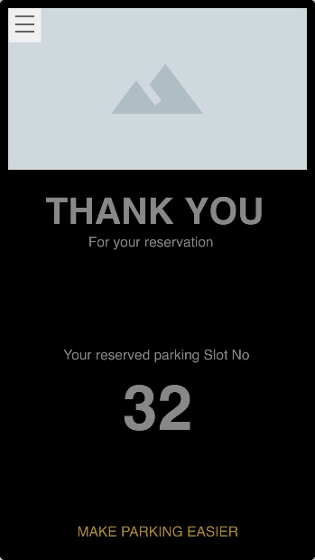
Prototype of the mobile application

Slide 10
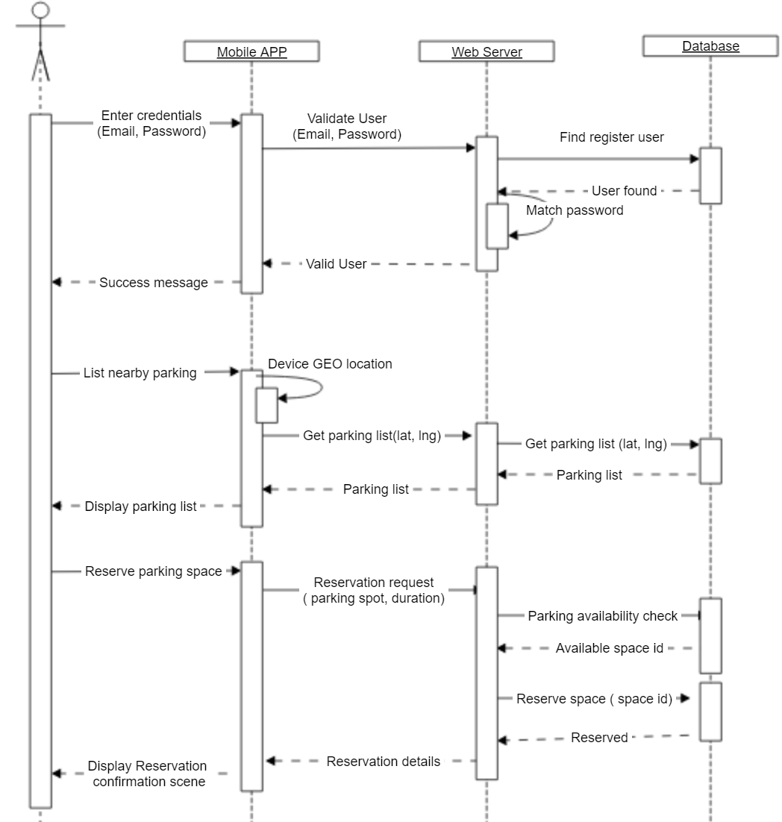
Sequence diagram

Slide 11
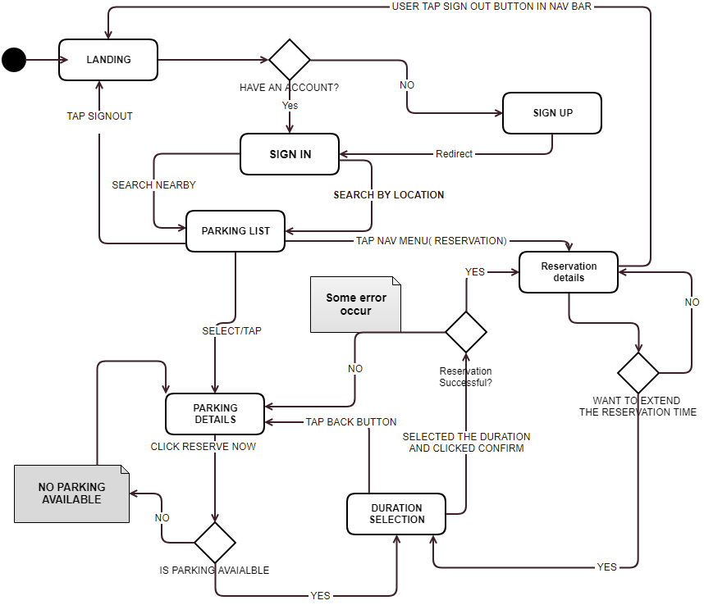
State
Diagram

Slide 12
CRC CARD
Reservation
User
Can reserve a slot
Knows number of available slot
Knows the start and end time of the reservation
Can change the end time of the reservation
Can set user information
Can return user information
Can set user role
Can return user role
User profile
UserProfile
ParkingSpotManager
MessageHandler
knows the address of all parking spots.
knows the number of total parking spots.
Knows the latitude and longitude of the parking spot.
Knows alert message
Send alert to the user
User
Reservation
parkingSpotManager
Knows user name
Knows user email
Knows user contact
Knows user password

Slide 13

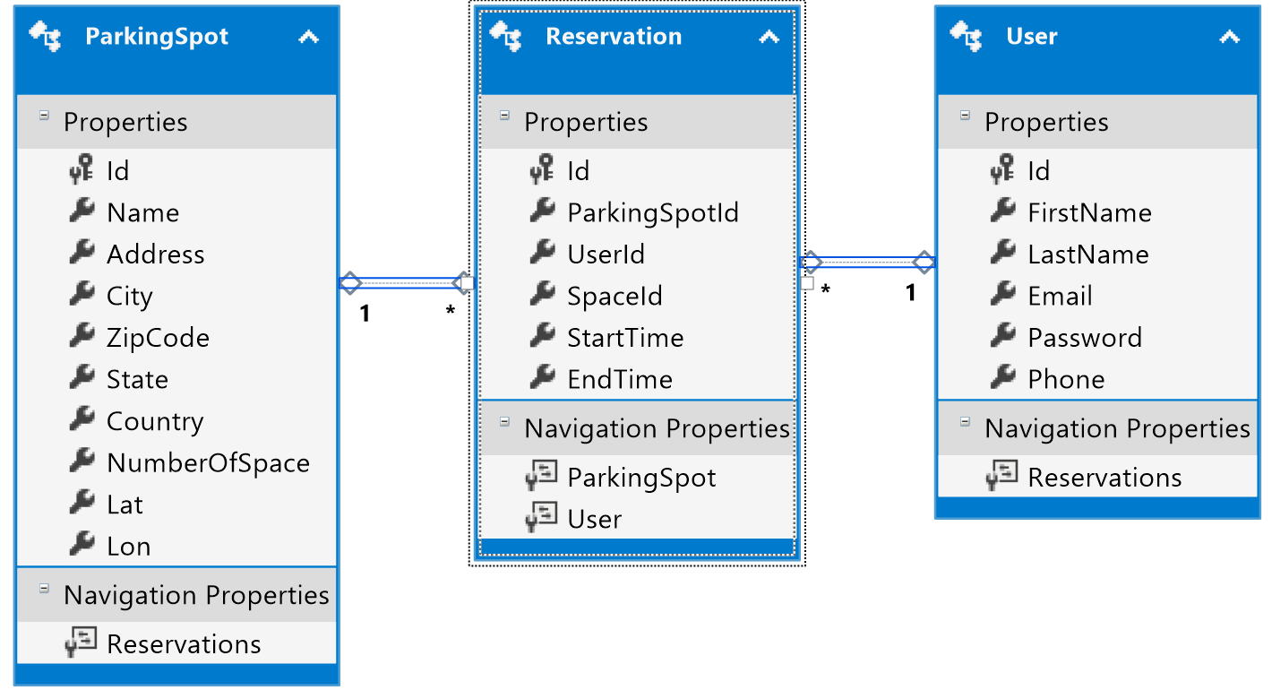



ER Diagram
1

Slide 14
System implementation
Our system can be divided into two parts –
web management system
parking module
user module
Reservation module
Mobile app
Signup
Login and
Nearby parking list
Parking spot details
Reservation details

Slide 15

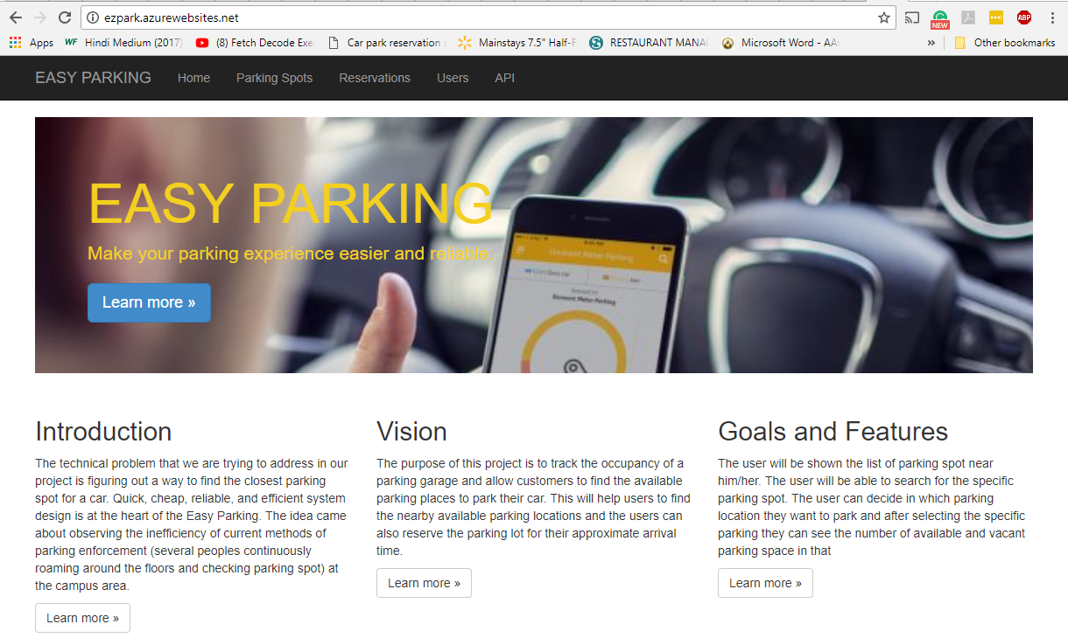

Slide 16
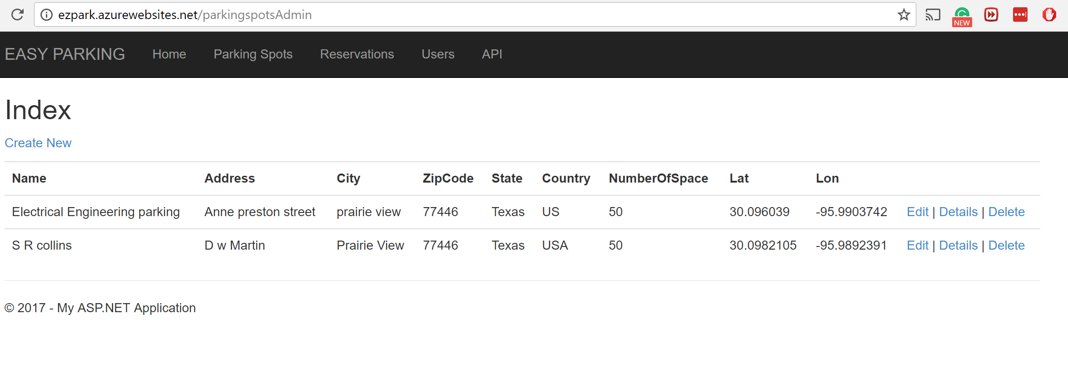
web management system
Web application Link:
http://ezpark.azurewebsites.net/
Parking details page in admin Website

Slide 17

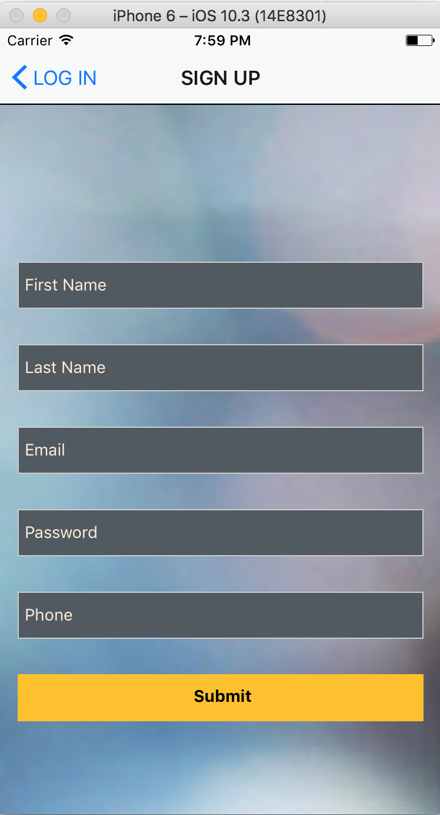
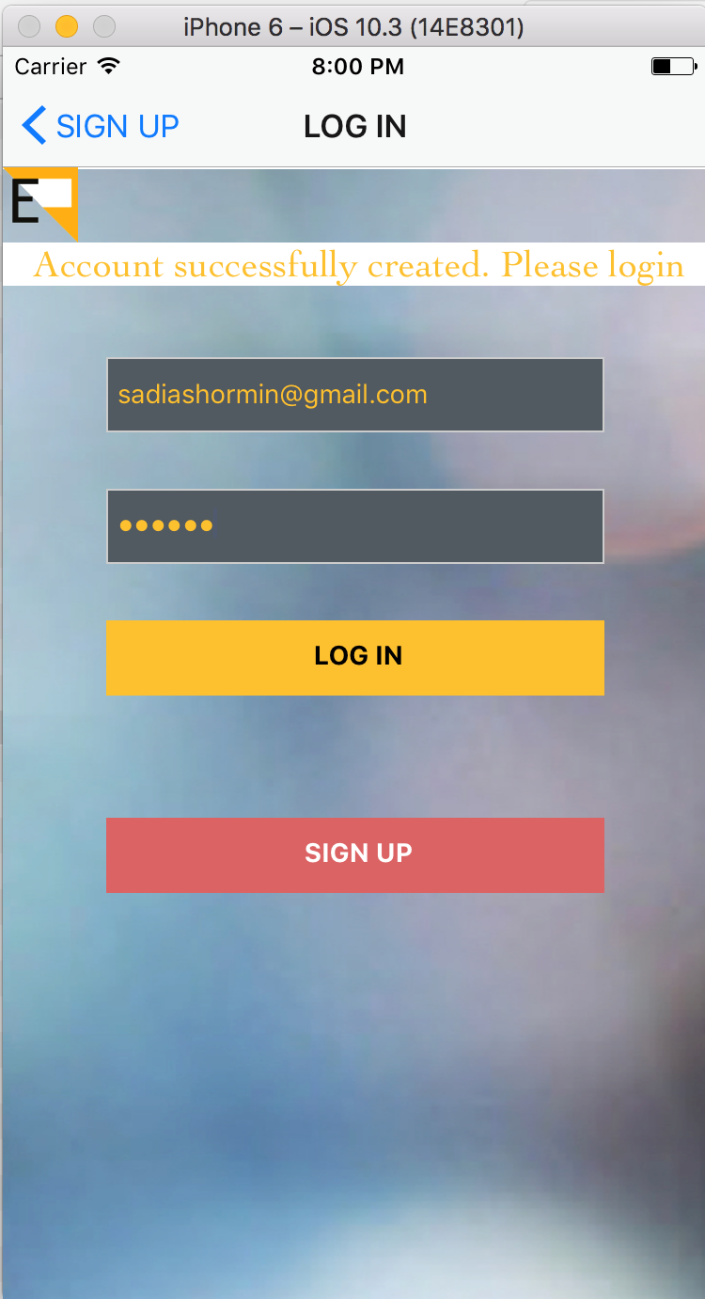
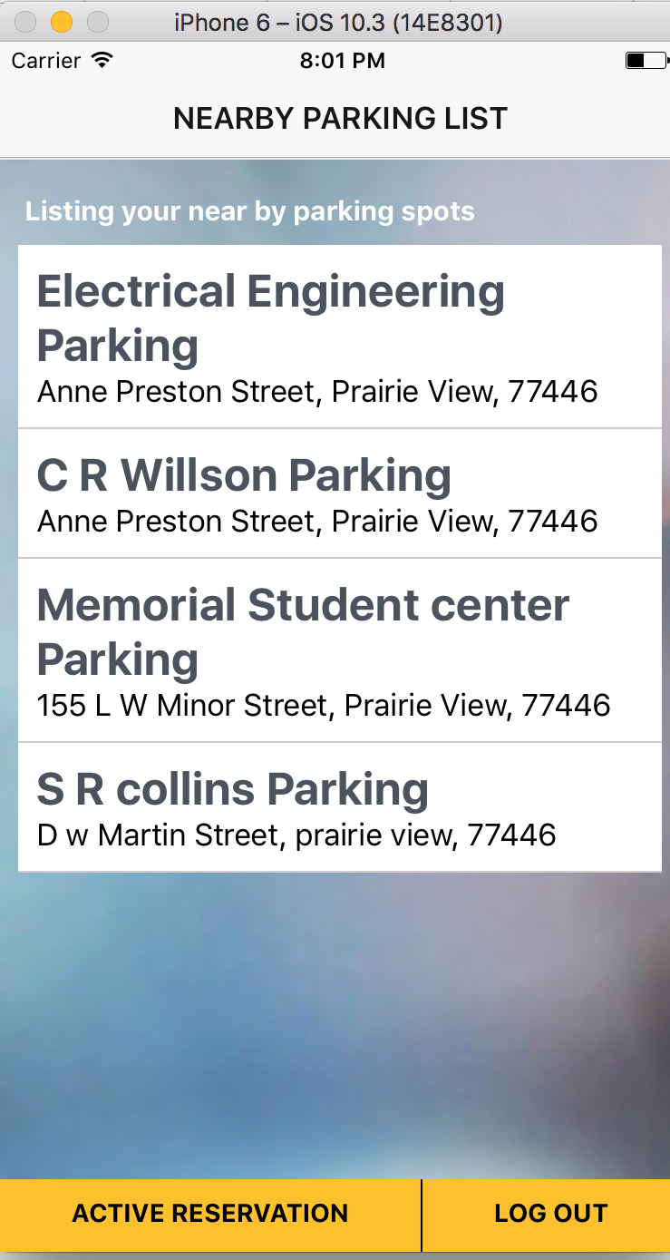
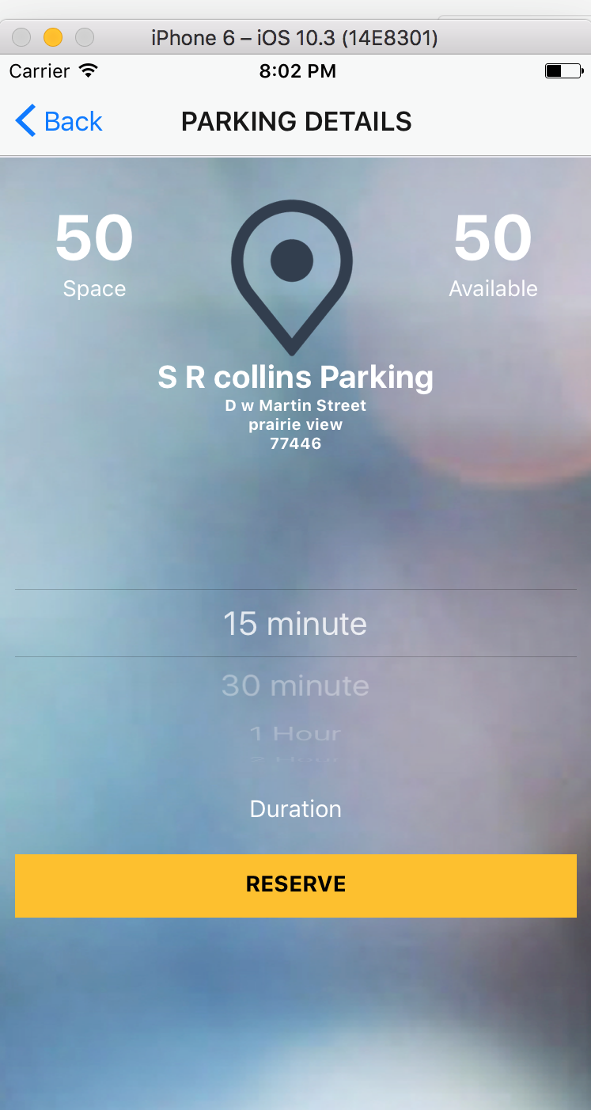
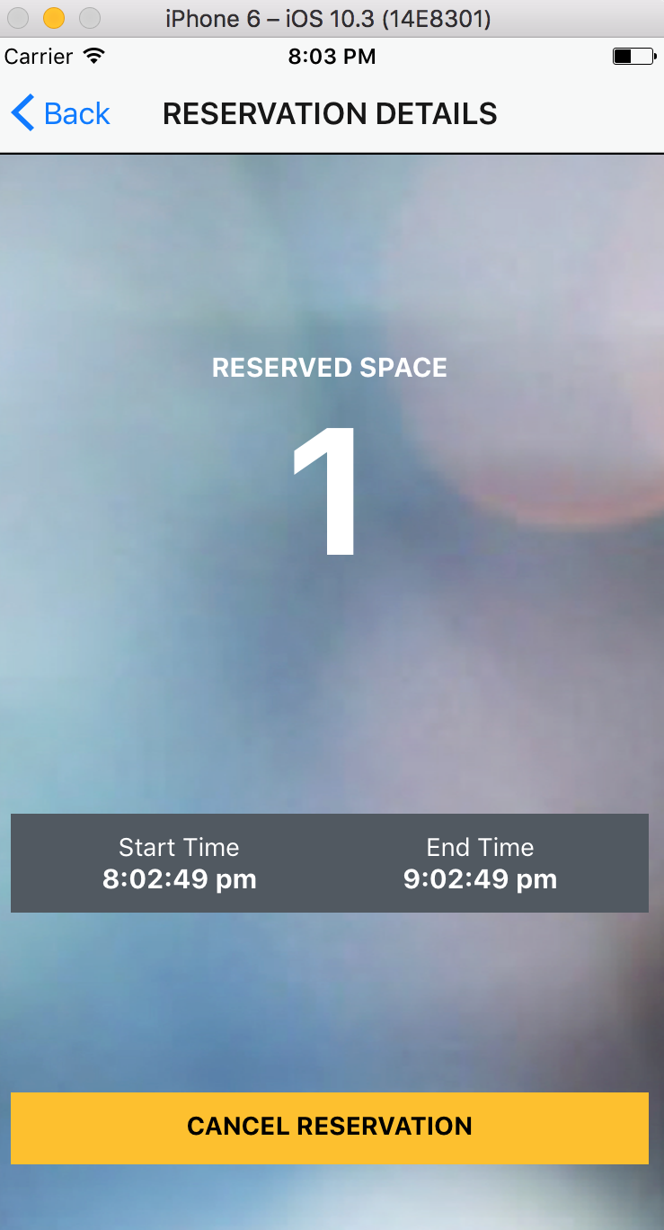
Mobile App Development
Sign Up
Log In
Nearby Parking
Parking Details
Reservation Details

Slide 18
System testing
TEST CASE TITLE: VERIFY REGISTERED USER IS BEING ABLE TO LOGIN
Step# | Test input | Expected | Observed | Status
Navigate to login page |  | Login page displays | Login page displays | Passed
Provide user credentials | Email: abc@xyz.com Password: ezPark!1 Contact: 674-674-878 | Successfully signed up | Successfully signed up
Click Login button | N/A | Navigate to parking list page | Navigate to parking list page
TEST CASE TITLE: VERIFY USER IS BEING ABLE TO RESERVE A PARKING SPOT
Step# | Test input | Expected | Observed | Status
Navigate to login page |  | Login page displays | Login page displays | Passed
Provide user credentials | Email: abc@xyz.com Password: ezPark!1 Contact: 674-674-878 | N/A | N/A
Click Login button | N/A | Navigate to parking list page | Navigate to parking list page
Select a parking spot | N/A | Display available parking space | Displays available parking space
Select duration and click reserve button | One hour | Reservation success message | Reservation Success message shown

Slide 19
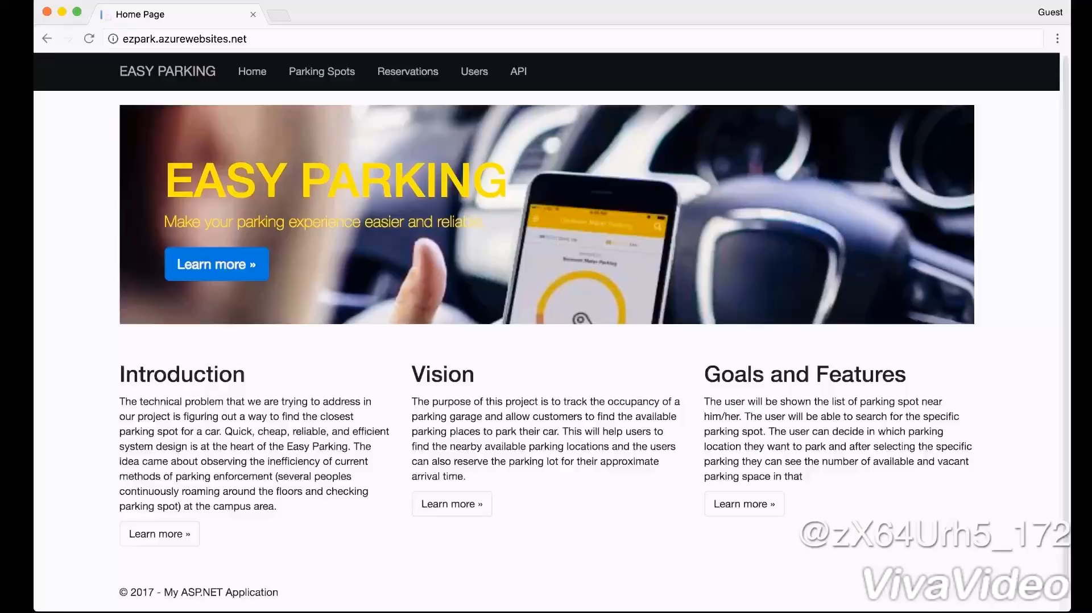

Slide 20
Conclusion
we have study the issues thoroughly, and we developed a software consisting of web based management front-end as well as a mobile client to assist the entire flow for easypark reservation from user signup, nearby parking searching, parking details, making reservation specifying the duration of stay and cancelling the reservation.
We delivered a system which is fully customizable and is flexible for admin to manage the parking, user and reservation information.
Besides, from the user’s point of view, they can reserve a parking space with no cost of instance reservation with a convenience system for searching and making reservation tackle the unnecessary queueing and cycling time issues for seeking an available car park space everywhere.

Slide 21
Thank you…

Slide 22

Any Questions???

